Slide 1


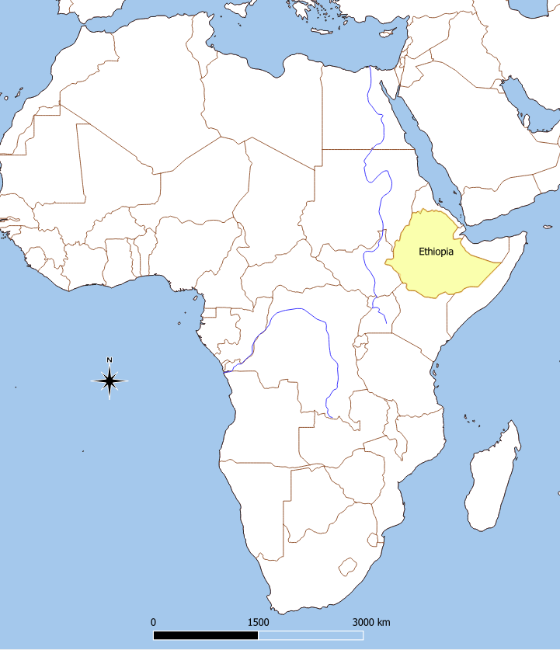
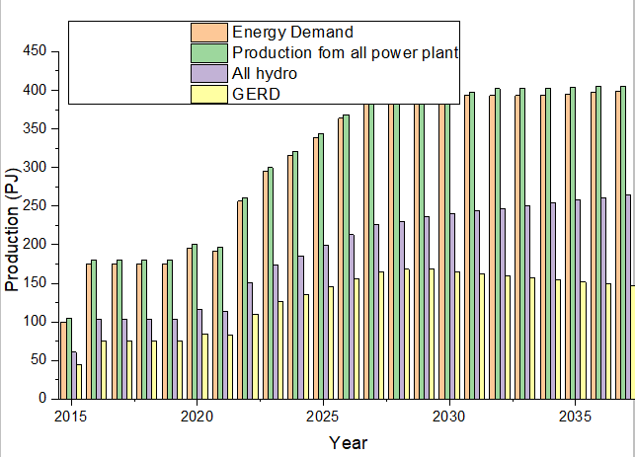
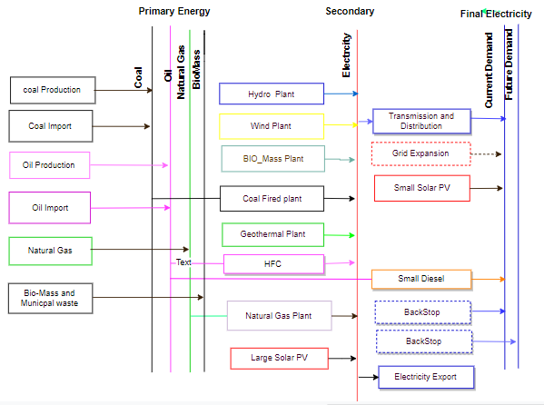
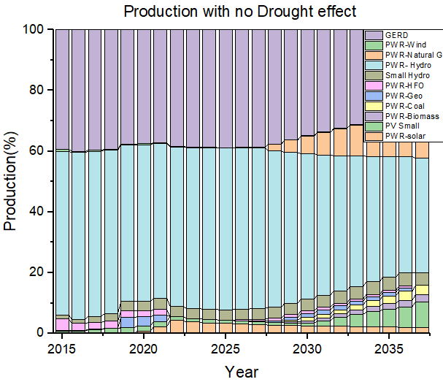
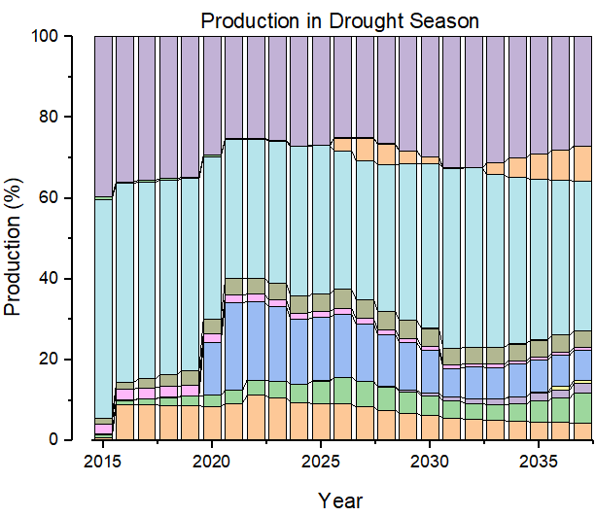

Reservoir inflow pattern and its effects on hydro-electric power generation in Great Ethiopia Renaissance Dam
Summer School on Modelling Tools for Sustainable Development – OpTIMUS, 10 – 28 June, ICTP, Trieste
Institution Logo
Tewodros Walle
Affiliation:Addis Ababa institute of Technology, Addis Ababa university
1. Context
2. Aim
Hydropower generation is vulnerable to droughts. The first large hydropower plant in Ethiopia, the Tekeze dam, was out of production for most of its first year after commissioning because of drought. The distribution of dams over different river basins reduces somewhat the risk of drought, which nevertheless remains substantial. out of hydropower potential of about 45,000 MW, only about 3850 MW (i.e. 8.56 %) has been exploited. The Ethiopian government has awarded contracts for mega plants. It is more ambitious of 90% of the future installed capacity in Ethiopia is from hydropower, and irrespective of hydrological effects from climate change. The coming climate change would affect the prominent Grand Ethiopian Renaissance Dam (GERD) with a dam volume of 10.2 million m3 and capacity of 6448MW.
This research is aimed at investigating the increasing hydro-dependency generation in Ethiopia and specifically to study significant relationship between Effect of river Nile reservoir inflow patterns on amount of GERD power generation from 2019 to 2037 .Finally, it indicate policy direction for risks from droughts which have on many occasions caused considerable power disruptions in countries.
Figure 1:Ethiopia
3. Methods & Scenarios
4. Results
The OSeMOSYS open source modeling tools was used which computes the energy supply mix (in terms of generation capacity and energy delivery) which meets the energy services demands every year and in every time step of the case under study. The data for energy demand projections, Primary energy resources and transmission and distribution system was collected from 18 different offices under Ministry of Water irrigation and Electricity, Ministry of mine and Natural Gas and Literature survey (reports from international organizations and journal articles).The model optimize the scenarios in terms of physical, economic, and environmental impacts. This “Drought” scenario is effect of lower river Nile inflow on GERD future production. Determination of the trend of reservoir inflow patterns in the study area was achieved by using trend analysis of 40 years nation’s river flow data as a reference. The mean for each variable for each year was first computed to actualize this and the worst dry season was considered as to being show up in the future.
Figure 3:production and demand
Figure 2. Reference Energy System
Figure 4 : Existing Model Production
Figure 5: production with drought scenario
5. Policy insights, conclusions and future work
6. References
Drop in hydro production in the dry scenario results in increased generation in costly coal fired,HFO ,natural gas and decrease the electric export and higher regional emission as well. The result also shows, for the reason, the generating capacity of the GERD decrease in proportional amount with the water inflow, therefore, the system would be forced in to load shedding Currently, the country is experiencing load shading .this study did not yield direct reasons for the Ethiopian government to swiftly stop pursuing its current ambitious national hydropower development plan,but the policy should encourage to adequately internalize an extensive range of factor: Energy Mix including environmental in order to adequately serve demand growth and electrification, Ensuring the variety of generation mix serves better in terms of reliability, cost reduction and security of supply.
[1] A. F. On, E. Prospects, and I. N. S. Africa, “Africa Energy Outlook.”
[2] T. Power and W. Sectors, Enhancing the Climate Resilience of Africa ’ s Infrastructure. .
[3] F. Democratic and R. Of, “Intended Nationally Determined Contribution ( INDC ) of the Federal Democratic Republic of Ethiopia,” pp. 1–13.
[4] F. D. Republic, I. Planning, and U. Access, “National Electrification Program 2 . 0 National Electrification,” 2019.
…
Contact: Tewodros Walle ,Energy Center, Addis Ababa institute of Technology, Addis Ababa university
Email: teddymec2@gmail.com

